Slide 1


Slide 2

?

Slide 3
5-10%
(According to chatGPT)
cleancube.netlify.appl

Slide 4



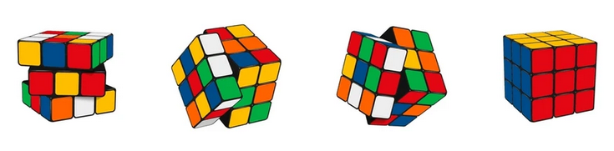
CleanCube
By Idan Nave & Amit Shitrit
cleancube.netlify.appl

Slide 5






INTRODUCTION
1 DAY X 1 CUBE
Enthusiasts of all levels.
Tools, Guides, Videos, 3D Sim
AI-Specific Solutions
Cube-state recognition
Shop

Slide 6



TARGET AUDIENCE
BEGINNERS WHO WANT TO LEARN HOW TO SOLVE A RUBIK'S CUBE.
ADVANCED SOLVERS AIMING TO IMPROVE ALGORITHMS AND ACHIEVE FASTER SOLVE TIMES.

Slide 7



PROBLEMS
No adaptive interactive guides
Lack of on-demand feedback
A giant leap from beginner to advanced
Notes:
אחרי 4 עובר להציג את האתר ברמת הLAYOUT

Slide 8


FEATURES & FUNCTIONALITY
Core Functionalities
1.Embeded iframe of a 3D cube
2.Step-by-step instructions for solving the cube.
3. Specific algorithms for each difficulty.
External API Integration
AI Prompting- adaptive algorithms for all skill levels.
Image Processing- high-quality response to
the OpenAI API.

Slide 9
DEVELOPMENT WORKFLOW
Concept proofing
Layout Phase
1.Create Wireframes for desktop and mobile layouts.
2. Create Dynamic elements.
Logic Phase
1.Build the HTML, CSS, and JavaScript structure.
2.Build a Node server and deploy it in Render.
3.Build an Image Processing Layer in Python.
4.Build an API requests\response module for OpenAi.

Slide 10
DEVELOPMENT WORKFLOW
Testing Phase
1.Cross-Screen Responsiveness
2.Repeatability
Tools
1.Code Editor: VS Code, pyChram.
2.Version Control: Git/GitHub for code management.
3.Testing: DevTools for responsive & functionality testing.
Hosting
1. Server- Render.
2. Deploy- Netlify.

Slide 11
CHALLENGES
1. Imagery Handling:
Color accuracy.
2. Seamless Integration:
Lack of control over the 3D model (3rd party)

Slide 12
CHALLENGES
3.AI Calibrating:
Fine-tuning AI models to generate high-quality algorithms for different levels of expertise.
4.Local Storage:
Dumped efforts of JSON transport, but implemented locally.

Slide 13
CONCLUSIONS
1. Server-side skills are crucial for working
with any AI / Algo-related apps
2. AI Data must be validated-
prompts must be clear & concise
3. Teamwork & Deadlines must be planned in advance,
each member should participate in both front & back aspects.

Slide 14
Qs?

Slide 15
Thank You

